Slide 1
Agriculture's Role in Climate change
Project 1-Group 5:
Nicole Pipkins, Yushan Sarah Gao, Roberto De La Torre, Sylvester Vredenburg, Sam Jebreen
Date: 09/22/2020

Slide 2
Hypothesis:
Analysis Questions:
How does CO2/GreenHouse Gas emissions from the agricultural sector compare by country focusing on the United states?
How does CO2/GreenHouse Gas emissions compare by sector globally focusing on the agricultural sector?
How does CO2/GreenHouse Gas emissions from the agricultural sector compare by livestock/field crops within the United states?
How does climate change affect weather patterns in the United States?
How does climate change over time affect crops yield within the midwest of the United States?
-The production and transport of crops and livestock contribute to greenhouse gas emissions.
- Climate change alters weather patterns which can negatively impact agricultural production.
-Agriculture both contributes to climate change and is affected by it.

Slide 3
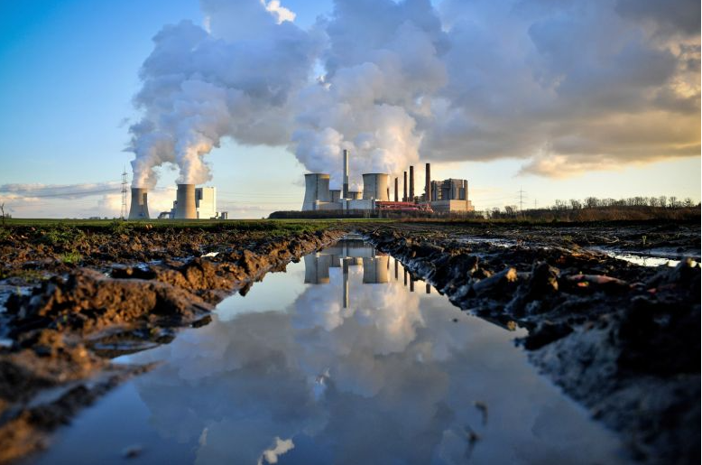
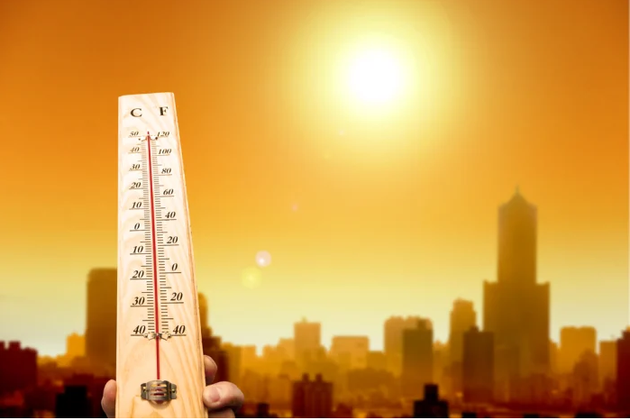
Global GHG Emissions and Climate Change
Where does the United States stand among all countries?
Sam Jebreen

Slide 4
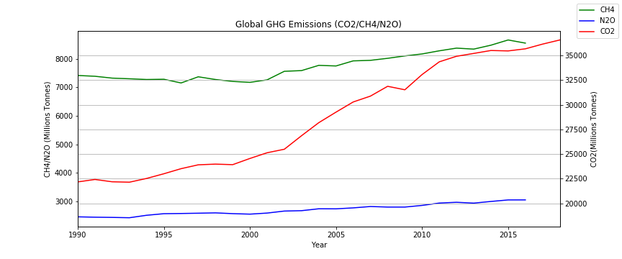
Global Greenhouse Gas Emissions (GHG)
Key Takeaways:
The main greenhouse gases are:
Carbon Dioxide (CO2)- 81%
Methane (CH4)- 10%
Nitrous Oxide (N20)- 7%
CO2 emissions contribute to the highest percentage towards emissions into the atmosphere.
Highest increasing trends compared to other gases over time.
~41% increase since 1990
CH4 is considered 30 times more potent as a heat trapping gas compared to CO2.

Slide 5
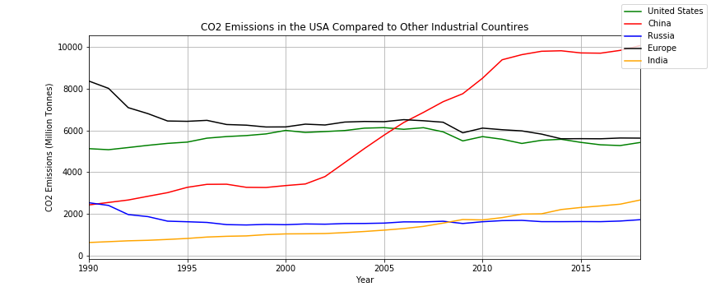
The Highest Co2 Producing Countries
Key Takeaways:
China is world's highest CO2 producing country where its trend has risen steadily producing >10 Billion Tonnes.
The United States considered to be the second highest CO2 Emitter.
USA showed close CO2 Emission rates to all countries combined in Europe.
USA was top CO2 producer until 2006 when China took over.
The US is responsible for 14% of CO2 emissions.

Slide 6
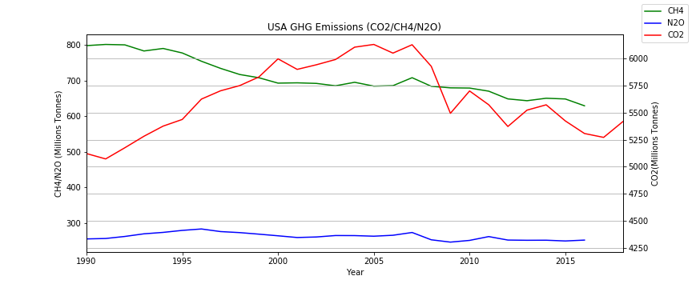
Comparing GHG Emissions In the United States
Key Takeaways:
Comparing CO2 Emissions to CH4 and N2O
Higher Trends of CO2 until 2006
US invested in technologies to help reduce gas emissions
CH4 and N2O emissions are lower but generally focused within the agricultural sector.
Agricultural states such as the state of california and Iowa will play a major role towards both gas types.

Slide 7
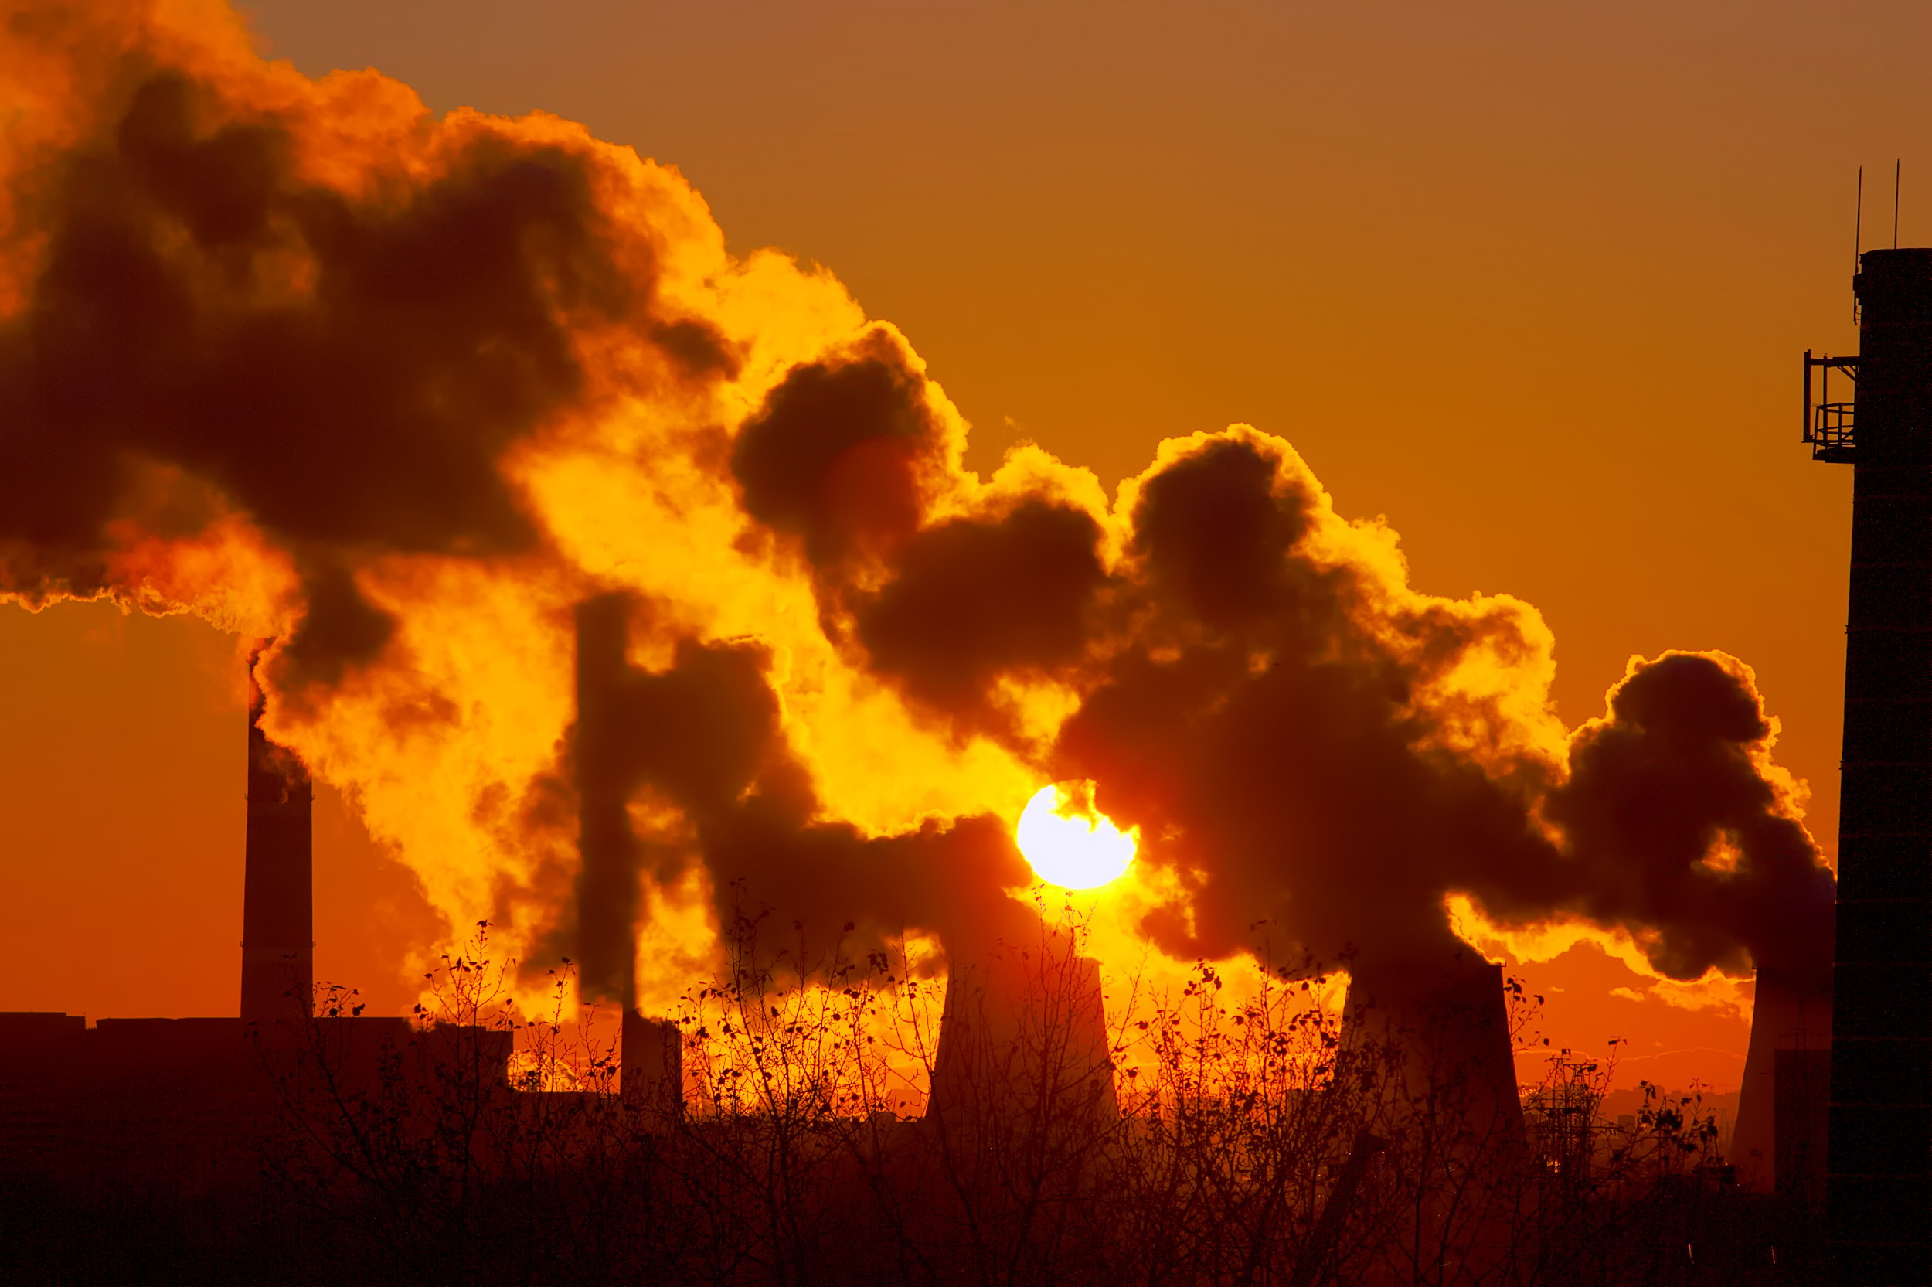
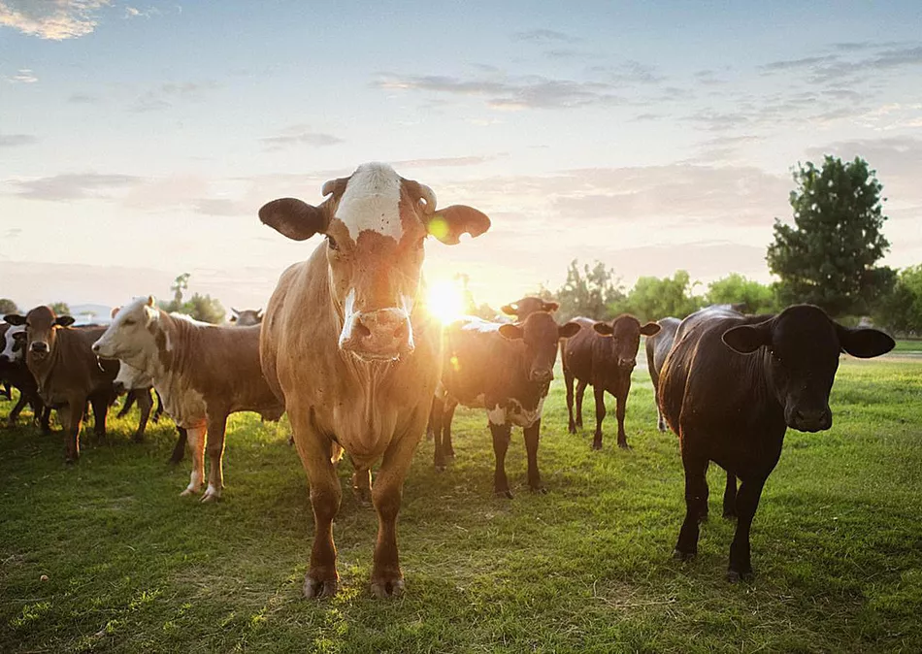
Greenhouse Gases by Economic Sector
Greenhouse Gases within the Agriculture Sector
Nicole Pipkins

Slide 8
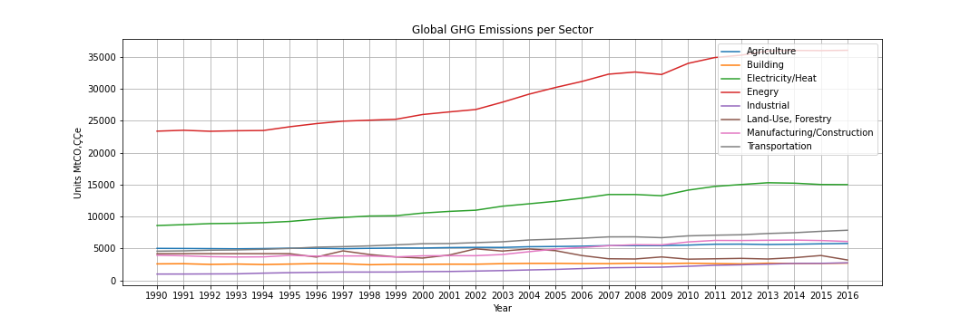
Global Greenhouse Gas Emission by Economic Sector
Key Takeaways:
USA, European Union, China, and India account for ⅔ of global energy emissions
Energy activities include: drilling for oil and gas, mining coal
CO2 emissions are not accounted for within the Agriculture sector; because CO2 emissions are coming from the equipment being used to farm, these emissions will be stored in Land-Use and Forestry

Slide 9
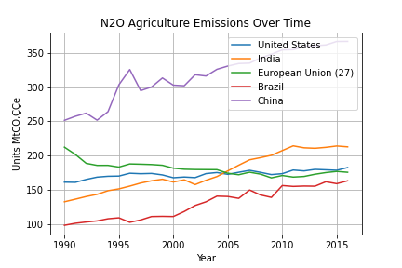
Agriculture Sector: Nitrous Oxide Emission Levels
Key Takeaways:
The agriculture activity that accounts for the most N20 emissions pertains to management practices for the soil
Other activities are drainage of soils and irrigation practices
N2O accounts for over half of the total emissions from agriculture
200 to 300 time more effective in trapping heat than CO2

Slide 10
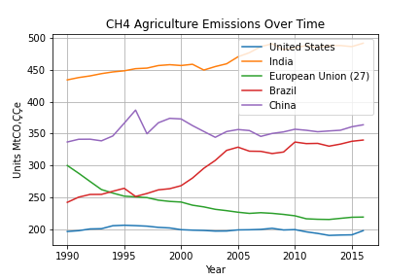
Agriculture Sector: Methane Emission Levels
Key Takeaways:
The agriculture activity that accounts for the most CH4 emissions is livestock digestion
Other activities are crop cultivation, like rice, and burning of crops
CH4 accounts for over a quarter of the total emissions from agriculture
Manure management accounts for about 12% of total GHG emissions from the agriculture sector
Very potent gas: trapes in heat that was intended to leave the atmosphere

Slide 11
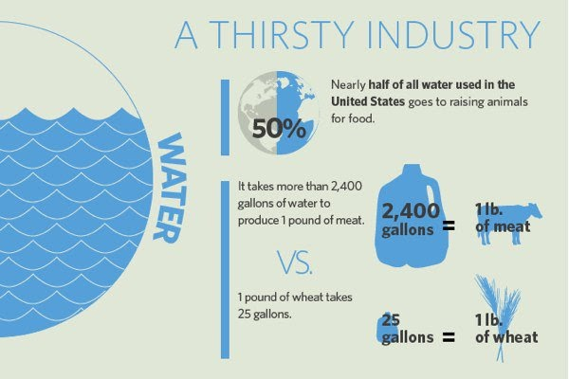
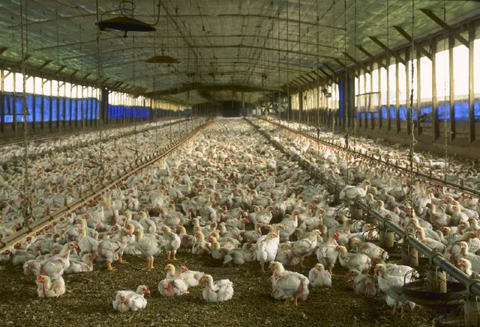
Meat Production
Sarah Yushan Gao

Slide 12
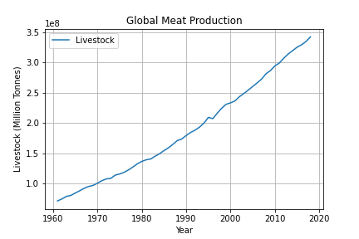
Global Meat Production
Key Takeaways:
Global demand for meat is growing.
Over the past 50 years, meat production has more than quadrupled.
The world now produces almost 350 million tonnes each year.
The increasing of meat production has large environmental impacts:
Increasing greenhouse gases emissions
Freshwater use
Effluent waste
Land consumption

Slide 13
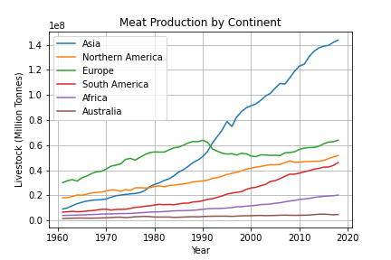
Meat Production by Continent
Key Takeaways:
Asia is the largest meat producer, around 40% to 45% of total meat production.
Next is Europe and North America
Were the dominant meat producers, accounting for 42% to 25%
By 2013 dropped to 19 %to 15%

Slide 14
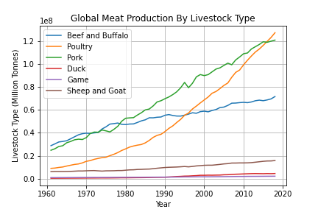
Global Meat Production by Livestock Type
Key Takeaways:
Dominant livestock type are poultry, cattle, pork, sheep and goat
Distribution of meat types varies significantly across the world
Wild game
Duck
Around 2013 Poultry approximately tripled

Slide 15
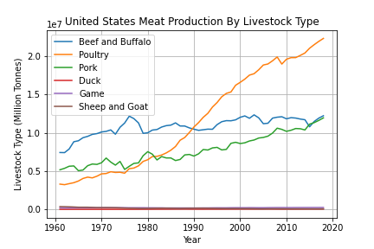
United States Meat Production by Livestock Type
Key Takeaways:
Poultry industry is the largest segment of the United States agriculture. After poultry it is beef and pork
United States exported about 3.7 million tonnes of poultry in 2017
Average American men eats about 4.8 ounces of meat per day and women eats about 3.13 ounces.

Slide 16
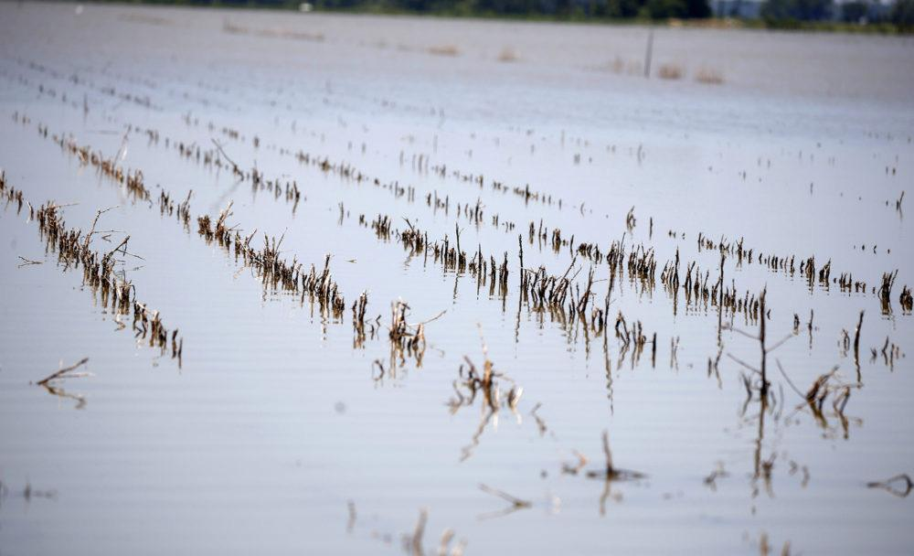
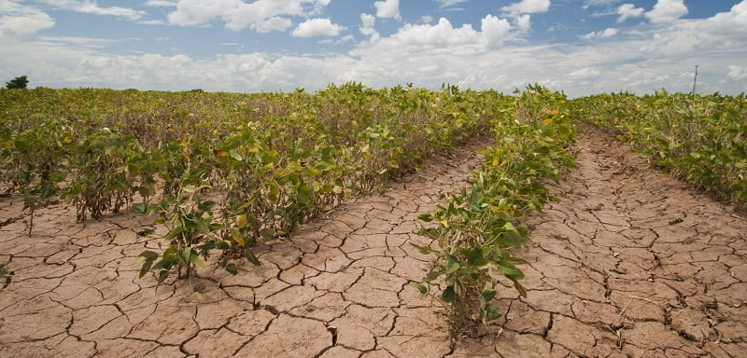
Extreme Weather Events
Effects of global emissions on weather in the United States
Sylvester Vredenburg

Slide 17

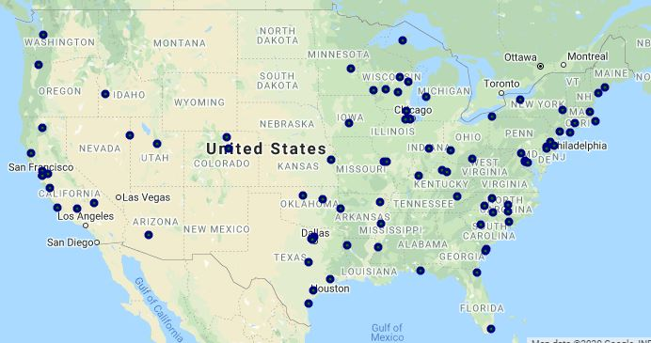
Using the Climate API

Slide 18
Extreme Heat
Event
Extreme Precipitation Event
An extended period of time (several days or more) with unusually hot weather conditions that potentially can harm human health.
A marked precipitation event occurring during a period of time of one to several days with daily precipitation exceeding a certain threshold defined for a given location.
https://www.wmo.int/pages/prog/wcp/ccl/documents/GUIDELINESONTHEDEFINTIONANDMONITORINGOFEXTREMEWEATHERANDCLIMATEEVENTS_09032018.pdf
https://www.cdc.gov/climateandhealth/pubs/ClimateChangeandExtremeHeatEvents.pdf

Slide 19
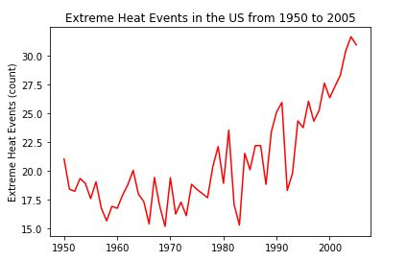
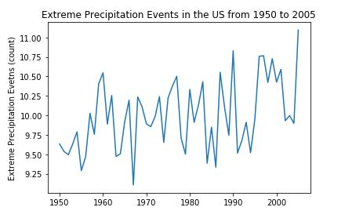
Extreme Weather Trends 1950 - 2005

Slide 20
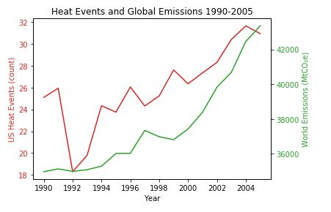
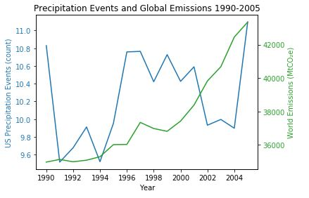
Effect of Global Emissions on Extreme Weather events in the United States

Slide 21
Weather Effects
On Iowa Corn and Soybean
Roberto De la Torre
Yield= is a measurement of the amount of agricultural production harvested per unit of land area.
Palmer Drought Severity Index =uses readily available temperature and precipitation data to estimate relative dryness. It is a standardized index that generally spans -10 (dry) to +10 (wet).

Slide 22
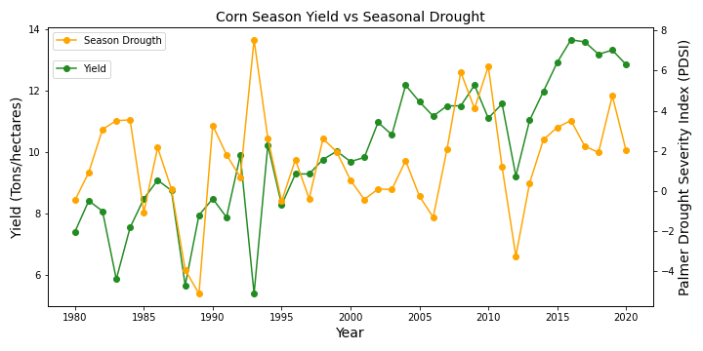
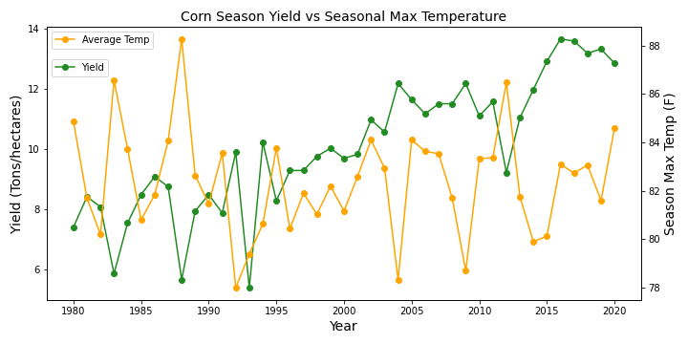

Slide 23
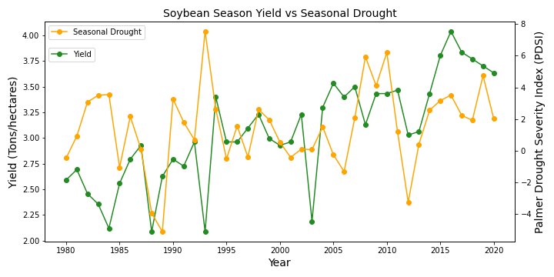
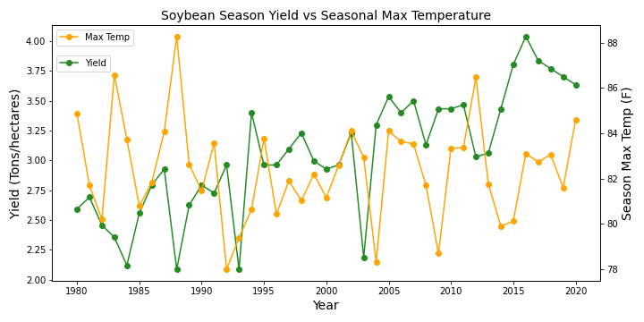

Slide 24
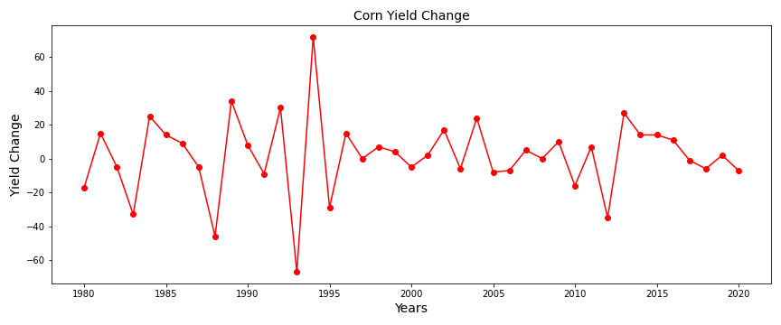
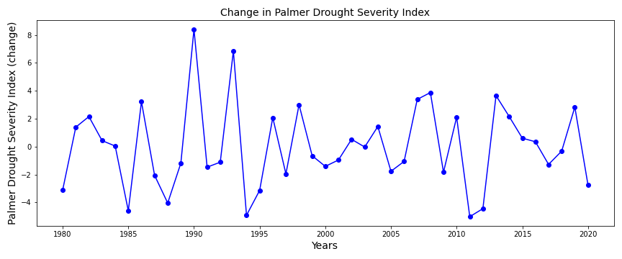
Iowa Corn Yield Change

Slide 25
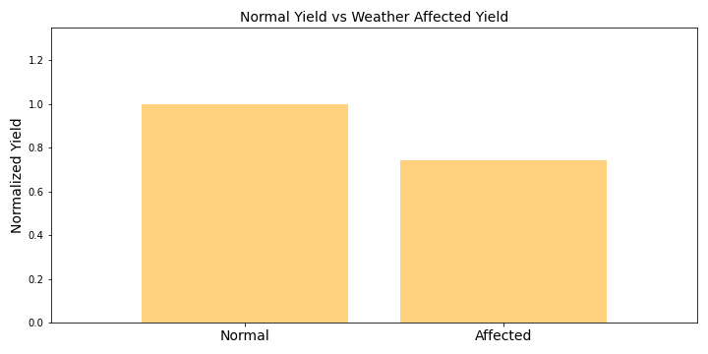
Iowa Normalized Corn Yield
Average Season yield vs Weather Affected Yield
p-value=5.96e-12
Shapiro test=0.503, 0.183

Slide 26
Key Takeaways
Extreme changes in weather, heat over 85 F and PDSI lower that 0 (dry) or higher that 6 (wet or flood) can decrease corn and soybean yield.
A decrease of ~ 20% in corn yield was observed when extreme weather occurred.
If climate change continues, these events of extreme weather may occur more often, adversely affecting crop yield.

Slide 27
Conclusions
The increase in agricultural production has led to an increase in global emissions.
Global emissions over the past few decades trend in the same upward direction as extreme weather patterns, and seem to be a likely cause.
The increase in extreme weather events has been shown to impact the crop yields in crop-producing states in the US.

Slide 28
Limitations
Lack of GHG emissions for some countries within some years. Missing values can skew the data causing outliers.
GHG Data is collected from different sources, the quality and the formatting were difficult to match between all data sources.
The change in GHG emissions from year to year can vary across different countries without analyzing each country separately defining the reasons for the change.
Difficult to find detailed livestock data in the different states that were user friendly

Slide 29
Q & A
Project 1- Group 5

